Slide 1


HUM 102 Report Writing Skills
Lecture 27

Slide 2

Previous Lecture
Basics of Interview
Interview Styles
Interview Types
Common Mistakes in Interviews
General Instructions for Interviews

Slide 3
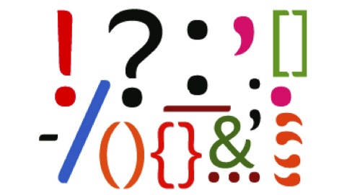


Punctuation Marks
Introduction
Punctuation: Application of signs, spacing and typographical devices for effective reading, interpretation and comprehension
These signs and symbols are known as punctuation marks
Punctuation marks perform a role in writing similar to stress, intonation, rhythm, pauses, hand or body movement in speech

Slide 4
Punctuation Marks
Full Stop/Period (.)
To mark the end of a sentence expressing a statement
“I live in Islamabad.”
“Please come at the station.”
“Have some tea.”
To signify an acronym
“N.A.T.O. for North Atlantic Treaty Organization”
Avoid the common mistake of using a comma for connecting sentences.

Slide 5
Punctuation Marks
Question Mark (?)
Used at the end of an interrogative sentence
“Where do you live?”
“Would you like to have some tea?”
“How old are you?”
Used to mention something uncertain
“He was born in 1952 (?) and died in 2011.”
Question marks should not be used to end an indirect question (declarative structure)

Slide 6
Punctuation Marks
Exclamation Mark (!)
To end an exclamatory sentence (with a lot of emotions)
Generally used to reflect surprise, shock, dismay
“Do not call on this number again!”
“Silence!”
“Go!”
Exclamation mark should not be used in formal writing

Slide 7
Punctuation Marks
Comma (,) [1/2]
For separating and listing the items, as a substitute of ‘and’/ ‘or’
“The three primary colors in RYB model are red, yellow and blue.”
To join two complete sentences alongside conjunctions ‘and’, ‘or’, ‘nor’, ‘but’, ‘while’, ‘so’, ‘yet’, etc.
“I can tell you the reason, but I will not.”
To show that one or more words have been left out being a repetition of previous words/phrases
“Some students use punctuations correctly; others, not.”

Slide 8
Punctuation Marks
Comma (,) [2/2]
Bracketing Comma: To insert additional information without affecting the actual meaning of a sentence
Commas used as a pair within a sentence
“This job fair, I would suggest, would be very helpful for job seekers.”
One comma in the beginning
“Although often wet, Britain has lots of sunshine.”
In case of listing, use Serial or Oxford Comma before ‘and’
“I need a paper, pen, and a pencil.”

Slide 9
Punctuation Marks
Semicolon (;) [1/2]
Used to separate equal parts of a sentence
“Ehsan is at office; Hasnain is at home.”
To join two complete and closely related sentences without any connecting word such as ‘and’, ‘but’
“It is a far, far better thing that I do, than I have ever done; it is a far, far better rest that I go to, than I have ever known.”

Slide 10
Punctuation Marks
Semicolon (;) [2/2]
To join two complete sentences where the second sentence begins with a conjunctive adverb: ‘however’, ‘nevertheless’, ‘accordingly’, ‘consequently’, and ‘instead’
“I wanted to make my speech short; however, there was so much to cover.”
To separate items in a list when one or more items are with a comma
“The speakers included: Tony Blair, the Prime Minister; Gordon Brown, the Chancellor of the Exchequer; and Ruth Kelly, Secretary of State for Education & Skills.”

Slide 11
Punctuation Marks
Colon (:)
To indicate that what follows is an explanation of what precedes
The pattern is (General Information to Specific Information) (General: Specific)
“There is one challenge above all others: the alleviation of poverty.”
To introduce a list
“There are four nations in the United Kingdom: England, Scotland, Wales and Northern Ireland.”
A colon is never followed by a hyphen (-)
A colon is never preceded by a white space
It is always followed by a white space

Slide 12
Punctuation Marks
Hyphen (-)
To separate syllables to make a word easier to read
Co-ordinate, Re-elect
Used in writing compound words which are hard to read and excessively long
No-smoking sign, black-cab driver
To join words or parts of words
Up-to-date
Sometimes, to change the meaning
Re-cover Vs Recover
Used when a number forms part of an adjectival compound
Nineteenth-century novelist

Slide 13
Punctuation Marks
Dash (–) [1/2]
To indicate a break in thought
“I’ll have a hot dog with mustard – no, make that ketchup.”
To separate a strong interruption from the rest of sentence
“All nations desire economic growth – some even achieve it – but it is easier said than done.”
To add parenthetical statements (in pair within a sentence and a single dash when the statement comes either at the beginning or end)
Dash is considered less formal compared with brackets

Slide 14
Punctuation Marks
Dash (–) [2/2]
To add emphasis or drama
“He said that he would go - and he did .”
To indicate a range of numbers
900 – 1000
To link two connected words
Sydney – Melbourne Train

Slide 15
Punctuation Marks
Parenthesis/Brackets ()
Contains extra information
Considered more formal compared with the use of Dash
“John (my brother) is coming to the party.”
To set off an interruption
“I knew that he would come (and I was right) to join us in the evening.”
To enclose an acronym
(EU) for European Union

Slide 16
Punctuation Marks
Quotation Marks/ Speech Marks/ Inverted Commas (“ ”)
To enclose the exact words of a person
Maria said, “The keys are on the table.”
Hamlet's most famous speech begins: “To be or not to be”
In case of quotation within quotation, use single quotation marks within double quotation marks
“Your use of the phrase ‘in this day and age’ is hackneyed.”
Scare quotes are used to express irony and sarcasm
“Daniel was assured that he would be 'safe' in the lion's den.”
Used when one wants to talk about a word or phrase
“One of my friends overuses the word ‘actually’.”

Slide 17
Punctuation Marks
Ellipsis/Suspension Marks/Omission Marks (…)
The omission of speech or writing
To show that the information is missing or deleted
To be or not to be. That is the question.
To be or not...the question
To show that some material has been omitted from a direct quotation
One of Churchill’s most famous speeches declaimed: “We shall fight them on the beaches ... We shall never surrender.”

Slide 18
Punctuation Marks
Apostrophe (’)
To indicate a contraction (formed by the omission of letters)
Isn’t for Is not
Aren’t for Are not
Can’t for Can not
To indicate possession
Dilawar’s Room
To be avoided in formal writing
Incase of plural, place the apostrophe at the end of a word (after s)
Workers’ rights

Slide 19
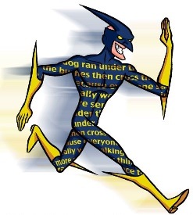
Run-On Sentence
Introduction
When two Independent Clauses (complete sentences) are written adjacent to one another but not connected properly
I love to play tennis I would play one match everyday if I had the time.
Comma Splice: Particular category of Run-On Sentence in which a comma is used to join two independent clauses
Participants could leave their session at any time, they needed to indicate their preferences.
Comma Splice also involves the use of transitional expression along with the use of a comma
The findings of the analysis are incomplete therefore, further research is needed.

Slide 20
Run-On Sentence
Correcting a Run-On Sentence
Using a Full Stop/Period
I love to play tennis. I would play one match everyday if I had the time.
Using a Semicolon
I love to play tennis; I would play one match everyday if I had the time.
Using a Comma and Coordinating Conjunction (and/or/but)
I love to play tennis, and I would play one match everyday if I had the time.
Using a Subordinating Conjunction (changing one independent clause to dependent clause)
Because I love to play tennis, I would play one match everyday if I had the time.

Slide 21


Run-On Sentence
Correcting a sentence using a period & a capital letter
Tyler delivered newspapers in the rain he got very wet.
WRONG! RUN-ON!
Tyler delivered newspapers in the rain. He got very wet.
RIGHT SENTENCE!

Slide 22
Run-On Sentence
Correcting a sentence using a semicolon
Kevin and his dog went for a walk it was a beautiful day.
WRONG! RUN-ON!
Kevin and his dog went for a walk; it was a beautiful day.
RIGHT SENTENCE!

Slide 23
Run-On Sentence
Correcting a sentence using a comma & a conjunction
On Monday we went outside for recess it was fun.
WRONG! RUN-ON!
On Monday we went outside for recess, and it was fun. RIGHT SENTENCE!

Slide 24

Determiners
Definition
Words placed in front of a noun to make it clear what the noun refers to
Words placed at the beginning of a noun phrase
Generally classified as:
Definite Article (the)
Indefinite Articles (a,an)
Demonstratives (this, that, these, those)
Possessive Pronouns (my, your, his, her, its, our, their)
Quantifiers (a few, a little, much, many, a lot of, most, some, any, enough)
Numbers (one, ten, thirty)
Distributives (all, both, half, either, neither, each, every)

Slide 25
Determiners
Indefinite Articles [1/3]
To generalize the noun phrase
To talk about persons and things in general
A (in case of a consonant in the following word)
A report, A letter
An (in case of a vowel in the following word)
An email, An application

Slide 26
Determiners
Indefinite Articles [2/3]
Both are used before phrases of time and measurement
Four times a week
100 kilometers an hour
Rs. 40 a kilo
Before phrases of jobs
A doctor
An engineer
A car mechanic

Slide 27
Determiners
Indefinite Articles [3/3]
With a noun complement
A good boy
A smart girl
Before phrases of nationality
An American
A Canadian
With words ‘half’ and ‘quite’
Half a pound of sugar
Quite an interesting story

Slide 28
Determiners
Definite Articles
To specify the noun phrase
When we believe the listeners and readers know what we are referring to
The is pronounced differently based on the following vowel/consonant
The Beginning vs. The Ending

Slide 29
Determiners
Use of Definite Articles [1/2]
The life of Bill Clinton vs. life is too short
The Smiths live in Chicago vs. Mr. Smith lives in Chicago
Names of Countries in plural, mountain ranges, regions: the United States of America, the Netherlands, the Highlands, the Rocky Mountains, the Middle East, etc.
Groups of Islands: the Bahamas, the British Isles, the Canaries

Slide 30
Determiners
Use of Definite Articles [2/2]
Names with of-phrase: the Statue of Liberty, the Tower of London
Names of Rivers, Seas and Oceans: the Nile, the Arabian, the Atlantic
Can be used with the names of the four seasons
Must be used with the American alternative for autumn, ‘fall’

Slide 31
Determiners
No Use of Definite Articles [1/3]
With a country name (if singular)
Germany, France, Italy, etc.
With names of languages
English uses many words of Latin origin
With titles and names
President Hussain
Prince Charles
Queen Elizabeth (the Queen of England)

Slide 32
Determiners
No Use of Definite Articles [2/3]
With years
1990 is a special year for my family.
Do you remember 2000?
With the names of individual mountains, lakes and islands
Mount McKinley is the highest mountain in Alaska.
She lives near Lake Windermere.
Have you visited Long Island?

Slide 33
Determiners
No Use of Definite Articles [3/3]
Mostly with the names of towns, streets, stations and airports
Victoria Station is in the center of London.
Can you direct me to Bond Street?
She lives in Florence.
They're flying from Heathrow.

Slide 34
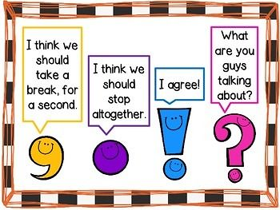
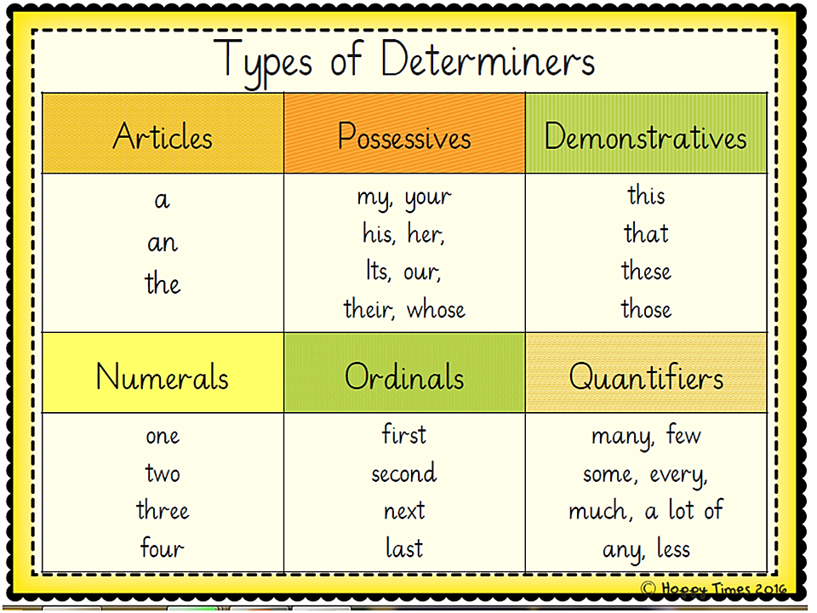
Conclusions
Punctuation Marks
Run-On Sentences
Determiners

